Slide 1

From Coding to Creativity: Using Sphero Robots to inspire STEM Learning
Dylan Long
thuy vy pham
Danielle Mathieu
TAP - Spring 2023

Slide 2

Meet Our Team
Dylan Long
Danielle Mathieu
Thuy Vy Pham

Slide 3
Technology Ambassadors Program (TAP)
The Technology Ambassadors Program (TAP) is dedicated to service learning and supports GGC's four pillars of scholarship, leadership, service, and creativity.
TAP has been recognized with awards for its efforts to address the underrepresentation of certain groups in computing and increase the number of students who continue with an IT major or minor.

Slide 4
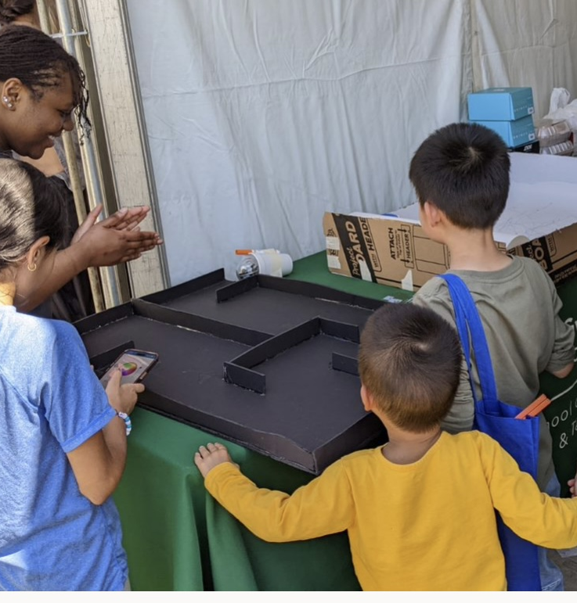
Our Project
Using coding to program a robot dancer.
Using Sphero Robot to draw pictures or designs by controlling its movements manually.
Modifying a program that changed the robot's matrix color and displayed text.
Assisting the Sphero robot in navigating through a maze to reach the endpoint.

Slide 5


Slide 6


Slide 7
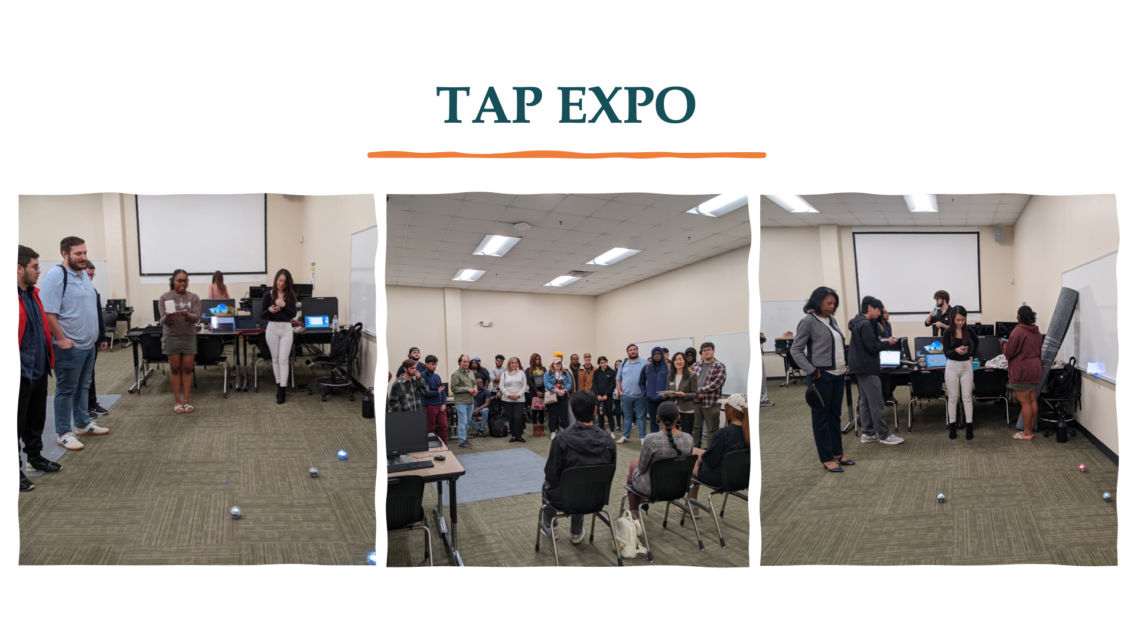

Slide 8
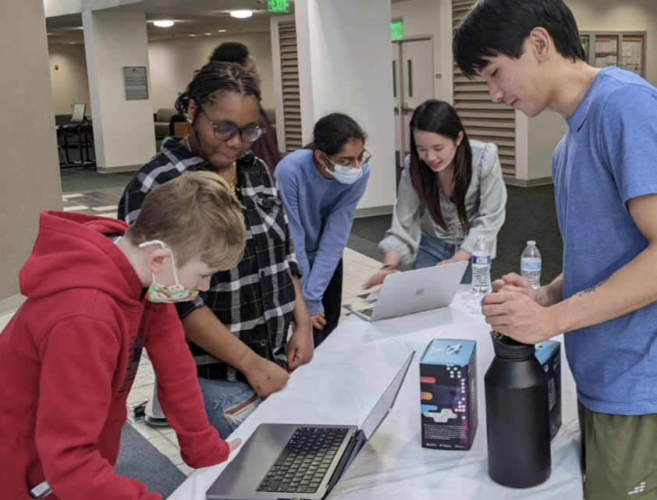
To encourage you to start exploring the Sphero Edu app, programming your robot, we will discuss the concept of functions, how to use them effectively, and how to create programs using functions in the Sphero Edu app.

Slide 9
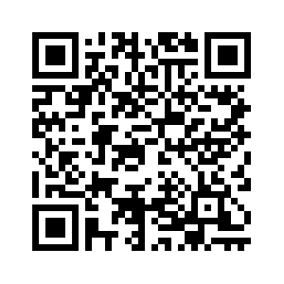
Before we start... Please take the pre-survey

Slide 10
What are Functions?
A function is a set of instructions that performs a specific task. It takes inputs, performs a series of actions on them, and produces an output.
Example of a function: multiply(x, y). This function takes two inputs, x and y, multiplies them together, and returns the product.
Functions are useful in programming to create a cleaner-looking program and to save you time.

Slide 11
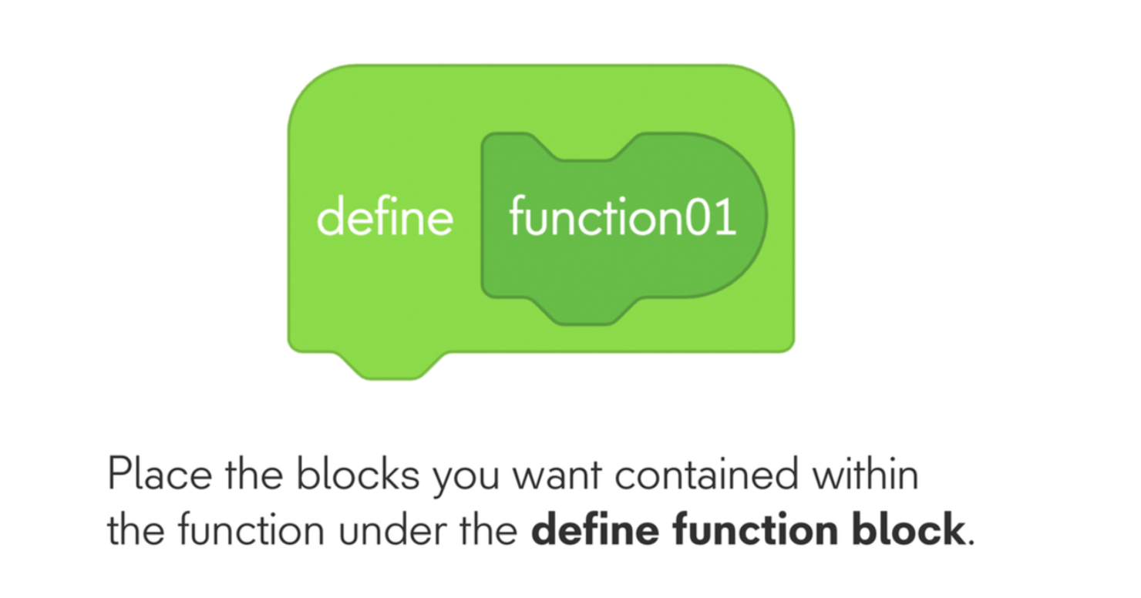
Sphero Edu App's Function Blocks
The Sphero Edu app provides a set of function blocks that can be used to create programs with functions

Slide 12
Creating a Program with Functions
Here is an example program that uses function blocks to control the movements of Sphero robot.
We will walk you through the program step by step and show you how the function blocks work together.

Slide 13
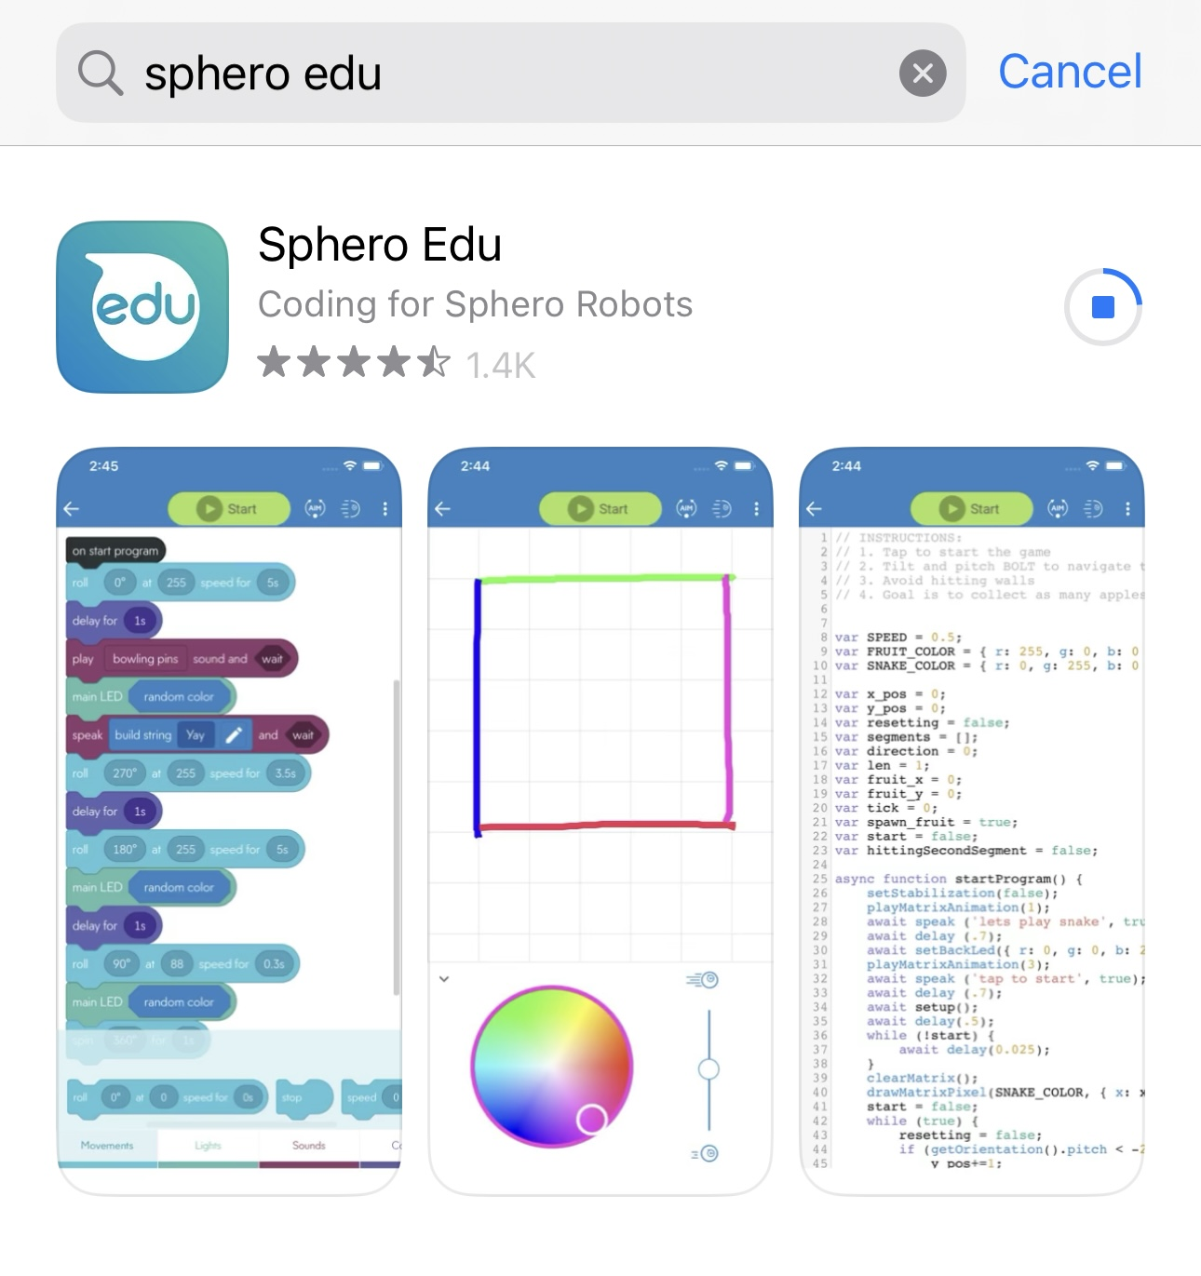
Download The App
Step 1: Go to the App Store or Google Play Store on your device.
Step 2: Search for 'Sphero Edu' in the search bar.
Step 3: Tap the 'Get' or 'Install' button to download the app.

Slide 14
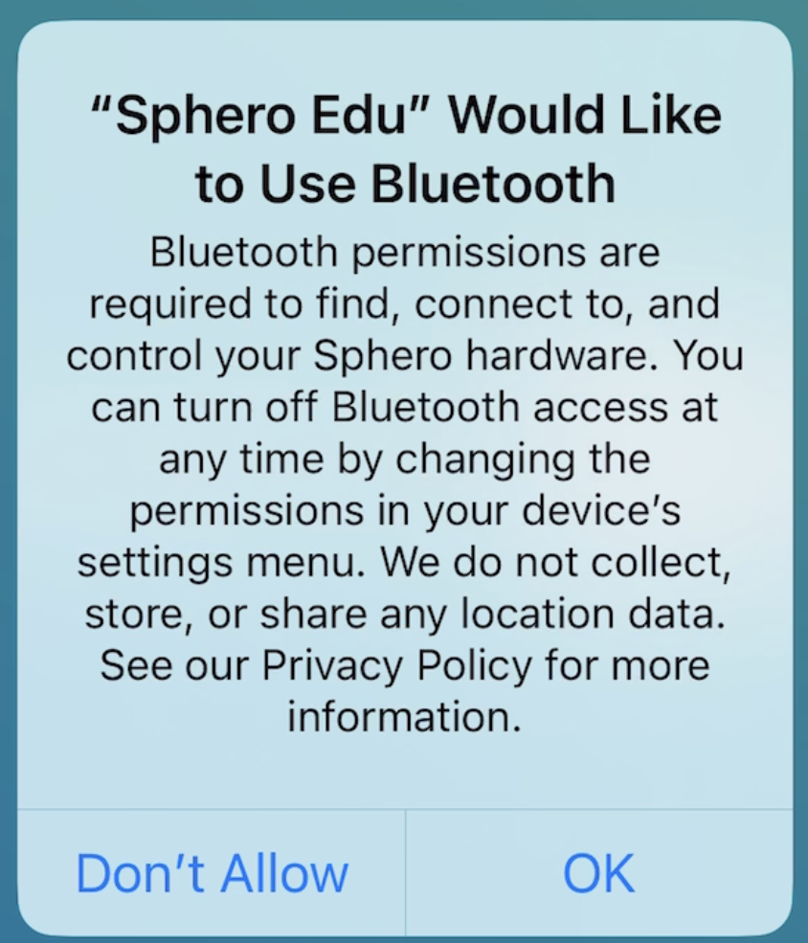
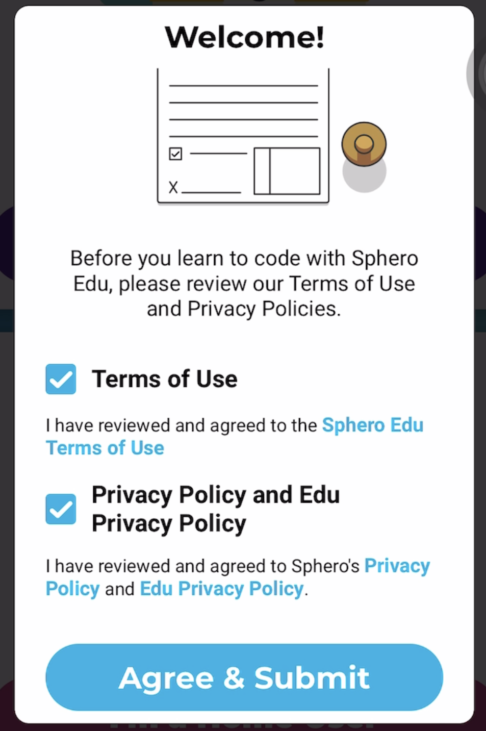


Slide 15
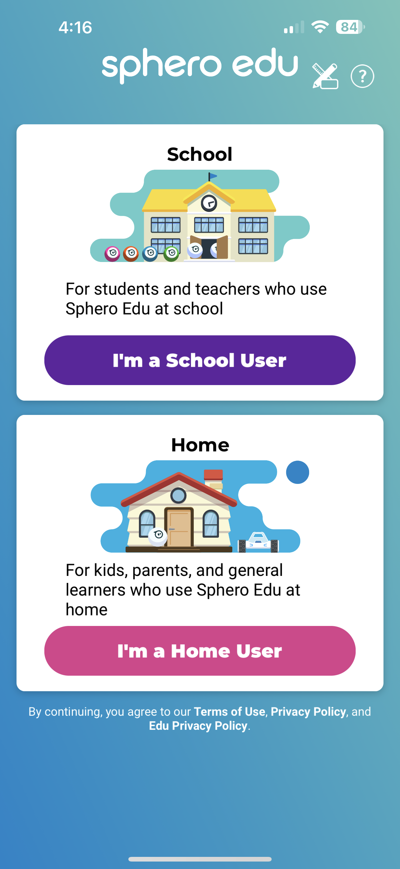
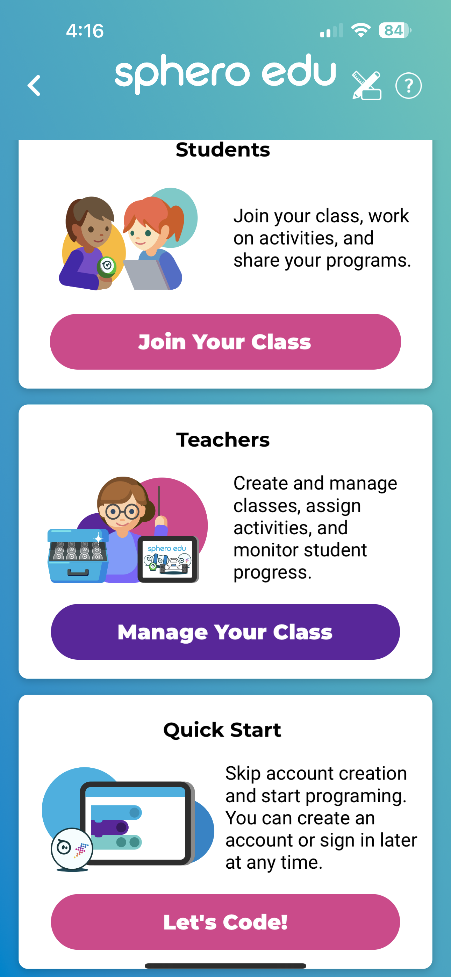
Creating an Account
Fill out the required information to create an account, or you can skip this step by clicking "Let's Code!"

Slide 16
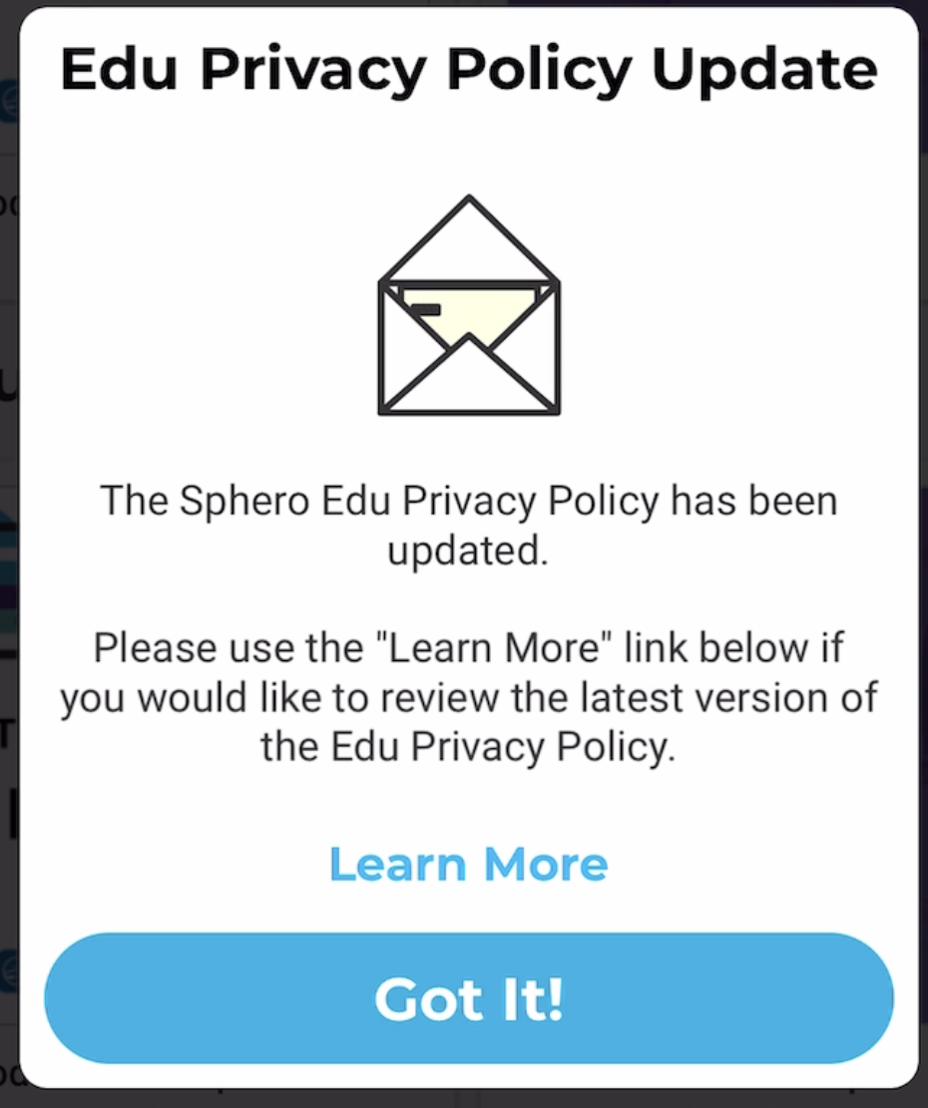

Slide 17
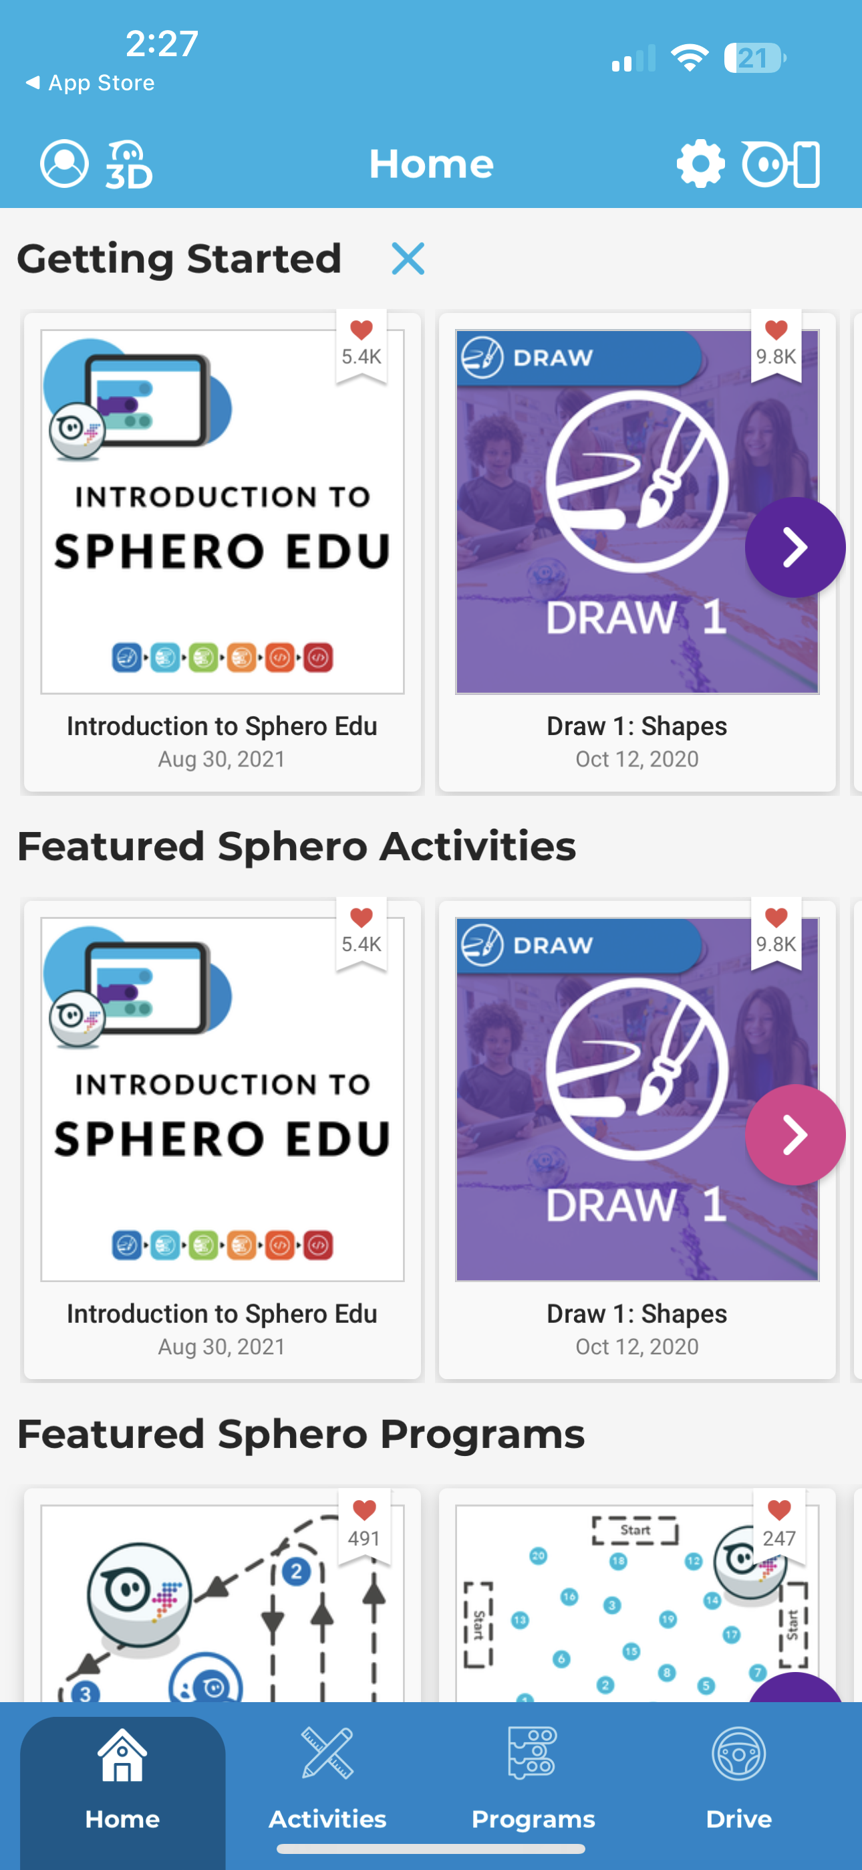
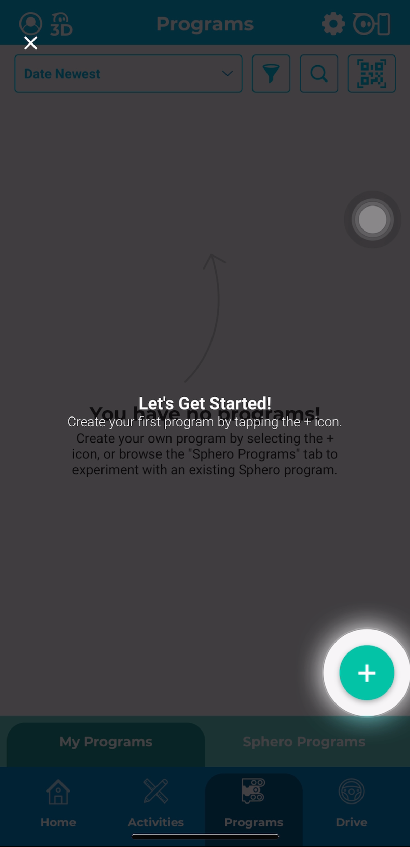

Slide 18
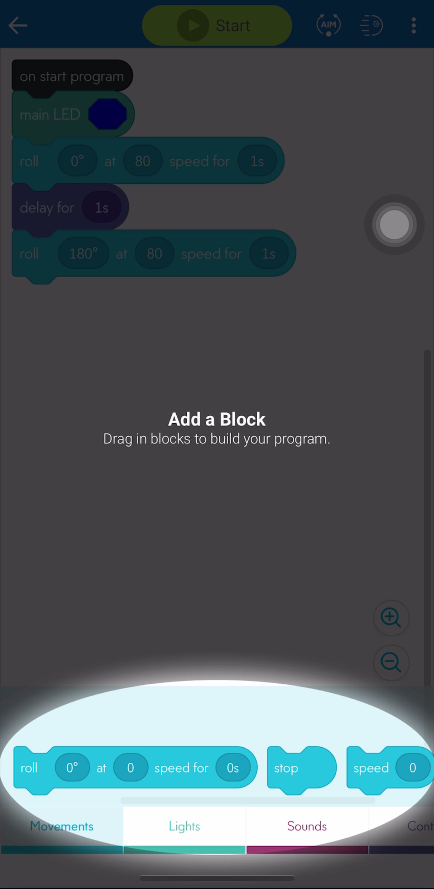
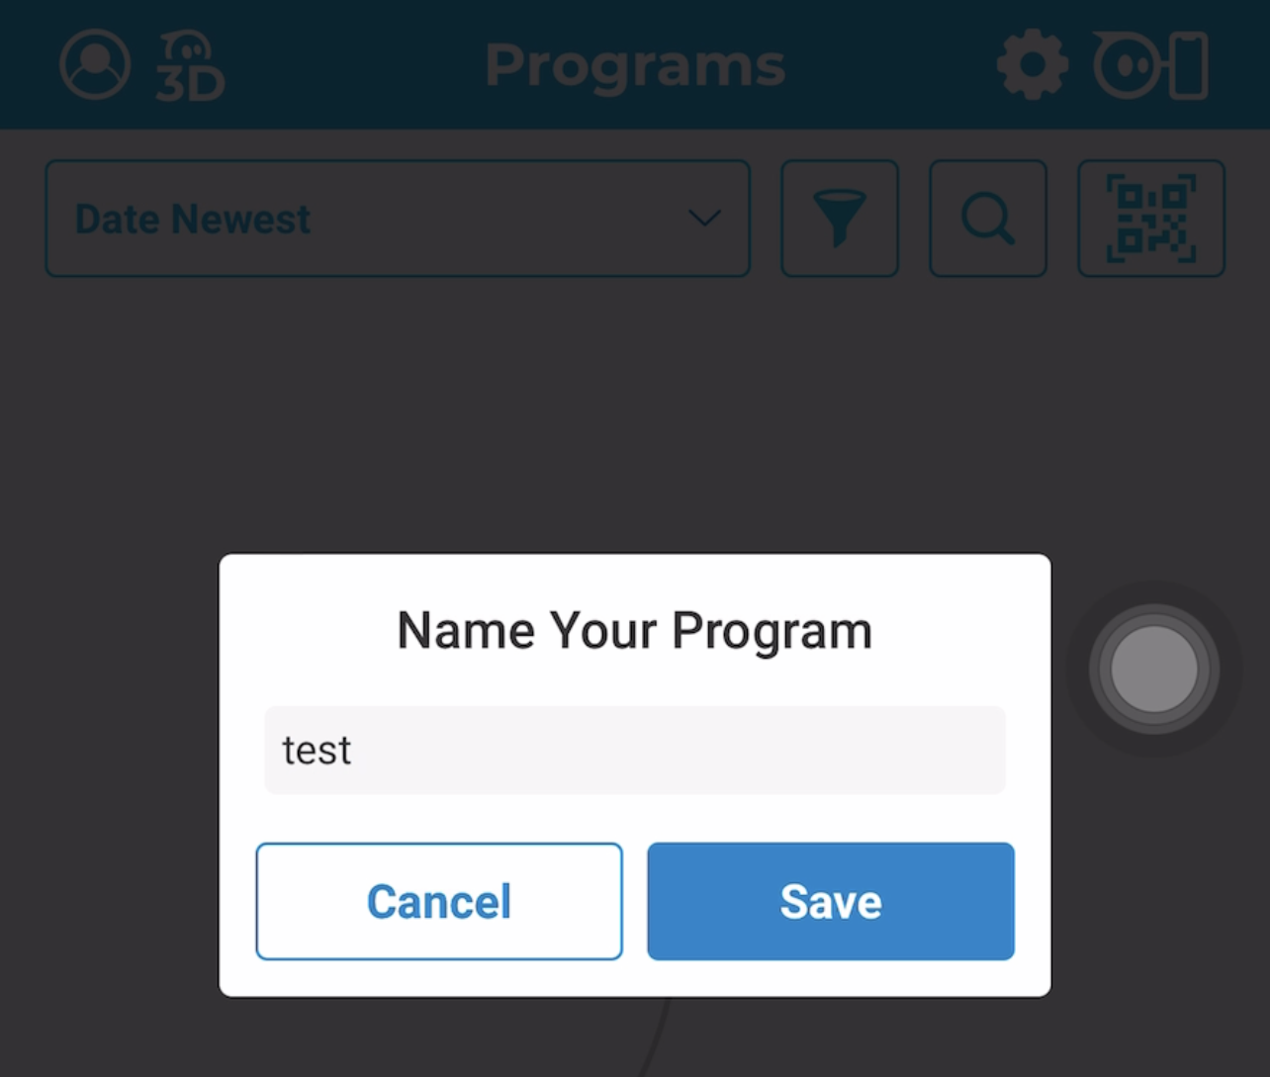
Name program to “test”
Click blank space in highlighted area

Slide 19
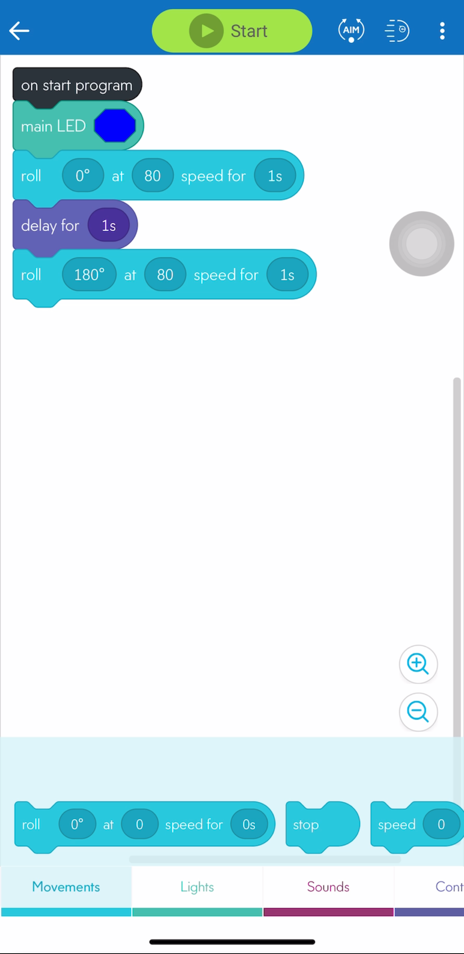
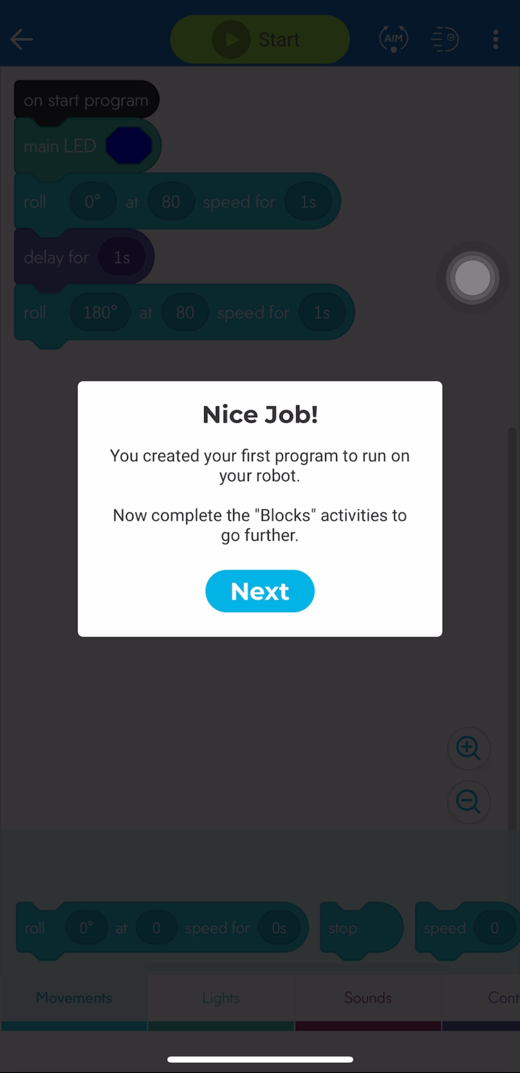
Click back arrow​

Slide 20
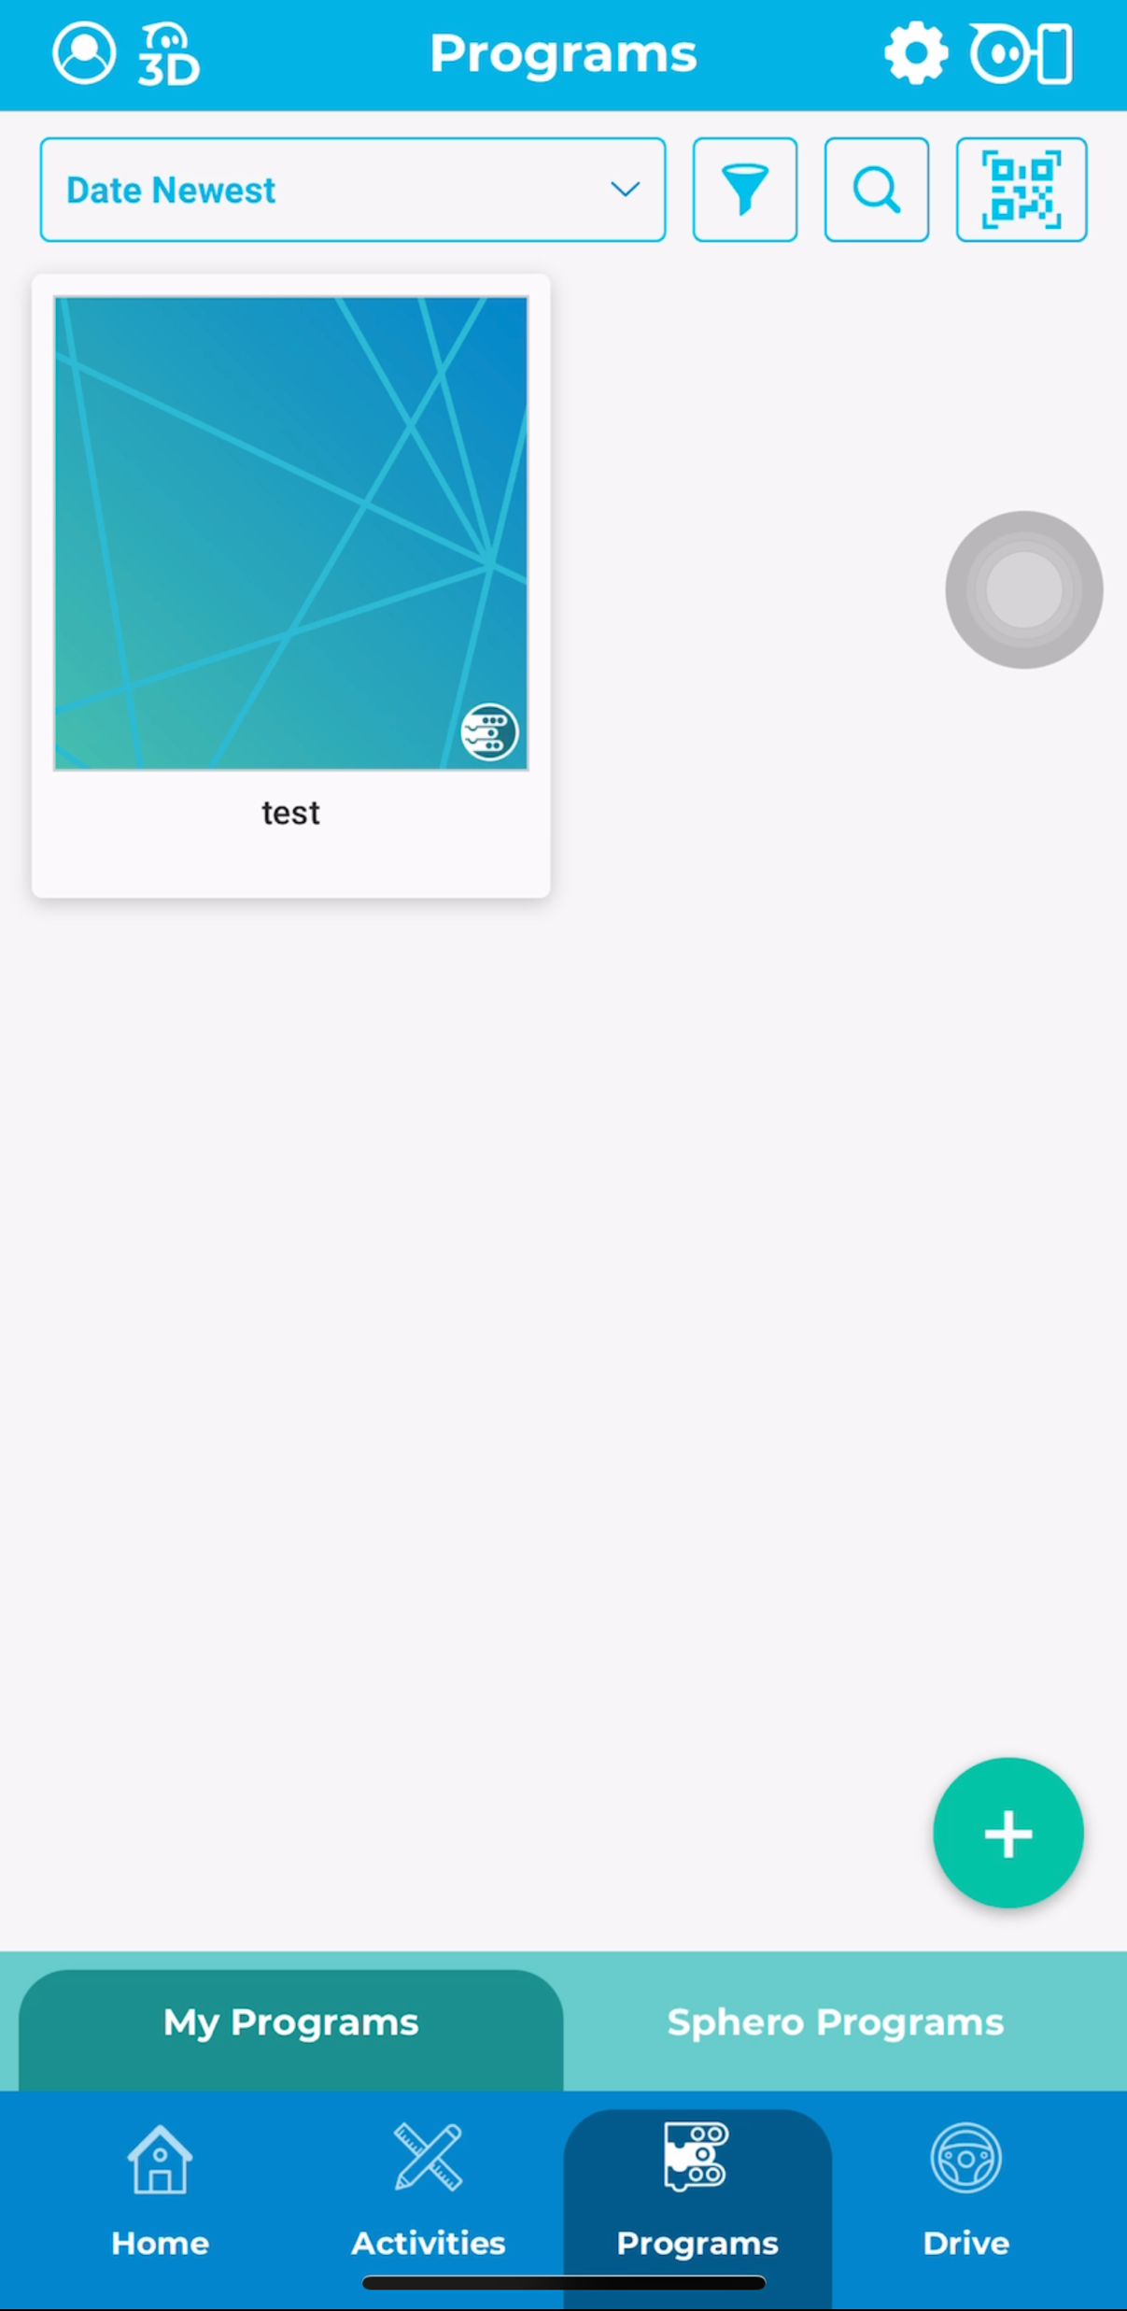
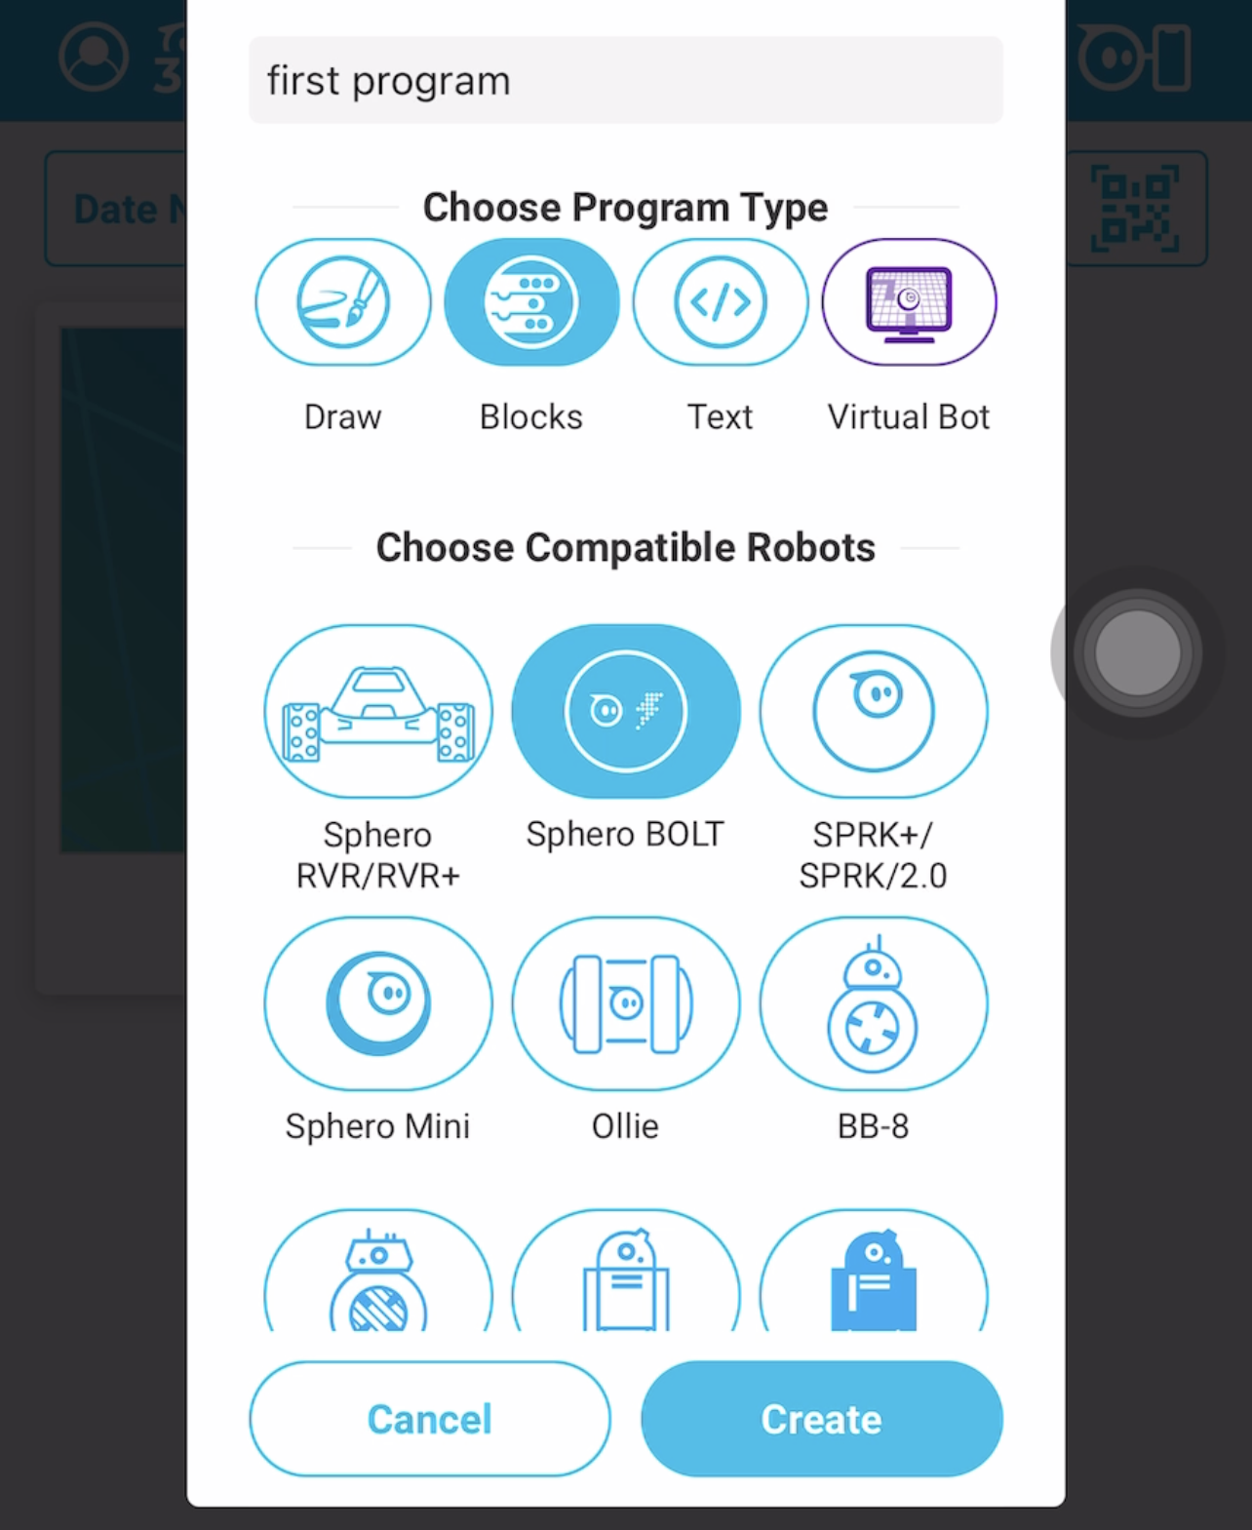

Slide 21
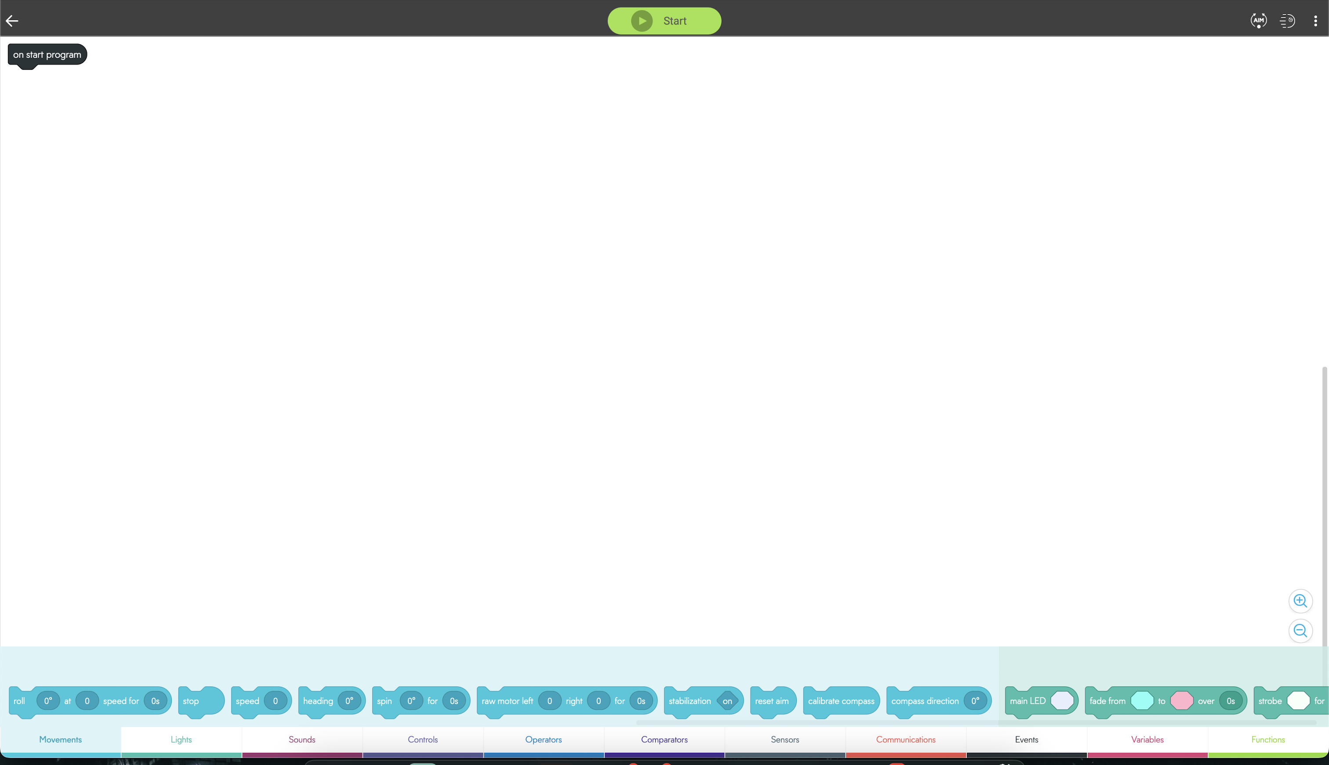
Click functions

Slide 22
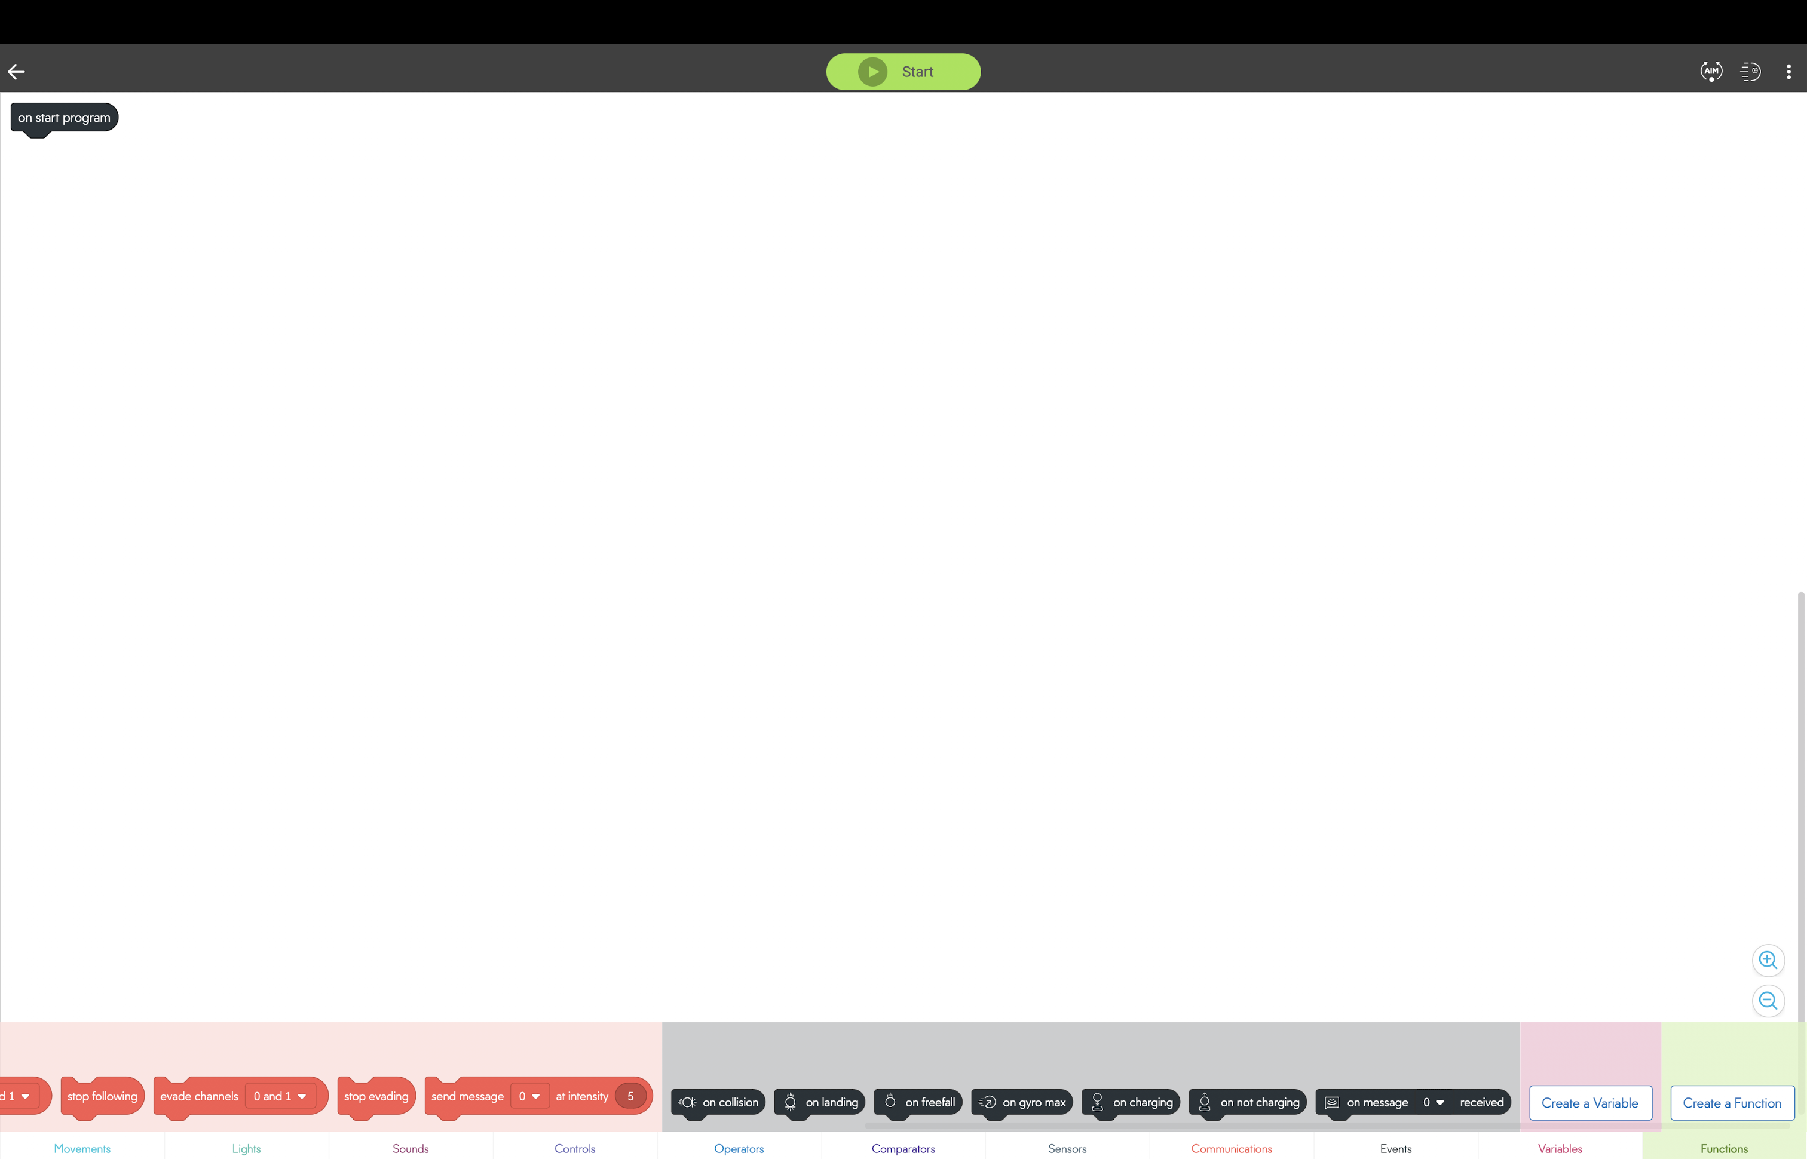

Slide 23
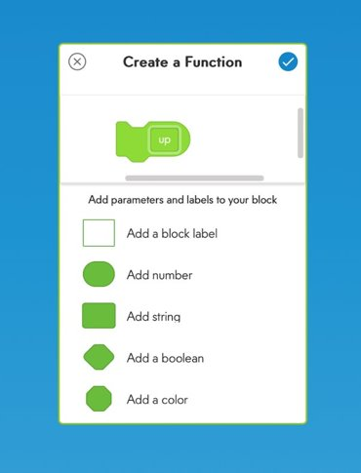

Slide 24
